Slide 1


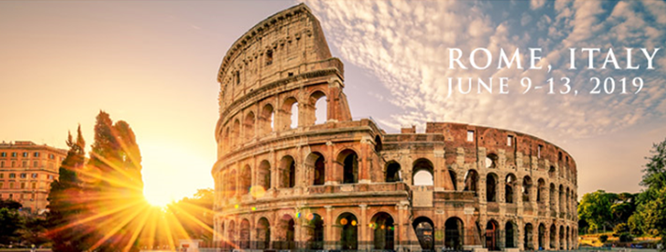
GENERAL ASSEMBLY
&
FEEDBACK FORUM
Celebrating 25 Years!

Slide 2
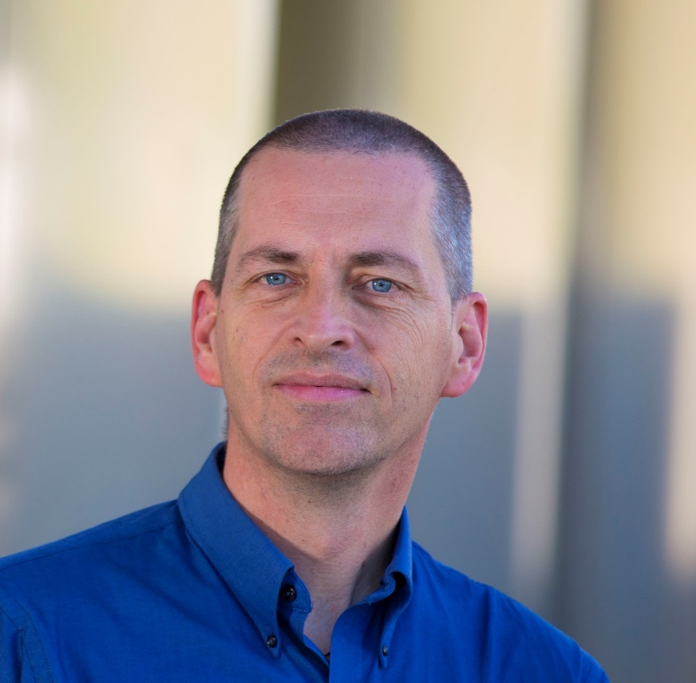
CHAIR’S REPORT
Vince Calhoun
Council Chair
Celebrating 25 Years!

Slide 3
GENERAL ASSEMBLY & FEEDBACK FORUM
AGENDA
Call to Order – Vince Calhoun, Council Chair
Chair’s Report – Vince Calhoun, Council Chair
Treasurer’s Report – Jessica Turner, Treasurer
Secretary’s Report – Shella Keiholz, Secretary
Program Chair Report – Lucina Uddin, Program Chair
Education Chair Report – Cameron Craddock, Education Chair
Feedback Forum – Vince Calhoun, Council Chair
Celebrating 25 Years!

Slide 4
NEWLY ELECTED COUNCIL MEMBERS
Chair-Elect: Aina Puce (USA)
Secretary-Elect: Svenja Caspers (Germany)
Treasurer-Elect: Anqi Qiu (Singapore)
Program Chair-Elect: Daniel Margulies (France)
Education Chair-Elect: Pierre Bellec (Canada)
Celebrating 25 Years!

Slide 5
2019/2020 OHBM COUNCIL
CHAIR: Jia-Hong Gao, China
CHAIR-ELECT: Aina Puce, United States
PAST CHAIR: Vince Calhoun, United States
TREASURER: Lilianne Mujica-Parodi, United States
TREASURER-ELECT: Svenja Caspers, Germany
PAST TREASURER: Jessica Turner, United States
SECRETARY: Juan (Helen) Zhou, Singapore
SECRETARY-ELECT: Anqi Qui, Singapore
PAST SECRETARY: Shella Keilholz, United States
PROGRAM CHAIR: Xi-Nian Zuo, China
PROGRAM CHAIR-ELECT: Daniel Marguiles, France
PAST PROGRAM CHAIR: Lucina Uddin, United States
EDUCATION CHAIR: Tom Nichols, United Kingdom
EDUCATION CHAIR-ELECT: Pierre Bellec, Canada
PAST EDUCATION CHAIR: Cameron Craddock, United States
Celebrating 25 Years!

Slide 6
Strategy Mountain
2018-2020
Mission
To advance the understanding of the anatomical and functional organization of the human brain and promote its medical and societal applications.
OHBM will...
Bring together researchers who are engaged in investigations relevant to human brain organization (MRI, fMRI, PET, EEG/MEG and other cutting edge approaches such as electrophysiology, preclinical imaging, neuroepidemiology, genetics); and
engage in other activities to facilitate communication among these scientists and promote education in human brain organization.
Celebrating 25 Years!

Slide 7
Core Strategies (2018-2020)
To expand OHBM's relationship with its membership by creating benefits and activities that foster strong member engagement.
To accelerate the development and adoption of new, effective education processes and strategies to engage and educate members on new approaches relevant to human brain organization.
To ensure OHBM as a Society has an infrastructure that supports the changing landscape for those who use neuroimaging to discover the organization of the human brain - this includes expanding engagement with other brain mapping communities and organizations.
To create an affordable, high quality publication platform, governed by the OHBM community and linked to governance including Council and ComCom.

Slide 8
STRATEGIC PLAN 2019 PRIORITIES
Infrastructure Development
Collaborations
Publishing Initiative – Aperture
Diversity & Gender
White Paper Development
Celebrating 25 Years!

Slide 9
INFRASTRUCTURE DEVELOPMENT
Appointment of Council Liaisons to Committees and Special Interest Groups
Leaders Round Table Meeting at Annual Meeting
New Committees to Implement Strategic Initiatives
Brain Art Special Interest Group
Celebrating 25 Years!

Slide 10
OHBM GOVERNANCE
Standards Task Force - NEW
SIG Task Force - NEW
Multi-Modal Task Force
25th Anniversary Task Force
FINANCE COMMITTEE
COMMUNICATIONS COMMITTEE
NOMINATING COMMITTEE
DIVERSITY & GENDER COMMITTEE
EDUCATION COMMITTEE
OHBM COUNCIL
AWARDS COMMITTEE NEW
FUNDRAISING COMMITTEE
NEW
PROGRAM COMMITTEE
CHAPTERS &
SPECIAL INTEREST GROUPS
TOPIC (Aperture)
LOCAL ORGANIZING COMMITTEE
SCIENTIFIC ADVISORY BOARD

Slide 11
CURRENT OHBM CHAPTERS &
SPECIAL INTEREST GROUPS
Latin American Brain Mapping Network (LABMAN) Chapter – approved June 2014
Student/Post Doc Special Interest Group – approved June 2014
Alpine Chapter (serving Austria and Switzerland) – approved December 2014
Brain Research Society Turkey Chapter – approved December 2014
China Chapter – approved June 2015
Korean Society of Human Brain Mapping Chapter – approved June 2015
Open Science Special Interest Group – approved February 2016
Australia Chapter – approved November 2017
Brain Art Special Interest Group – approved November 2018

Slide 12
COLLABORATIONS
European Society of Neuroradiology (ESNR)
International Federation of Clinical Neurophysiology (IFCN)
International Neuroinformatics Coordinating Facility (INCF)
World Health Organization (WHO)
German Society for Clinical Neurophysiology and Functional Imaging (DGKN)
Society of Biological Psychiatry (SOBP)
Global Brain Consortium
Alzheimer’s Association Conference
Brain Initiative PI Group
Celebrating 25 Years!

Slide 13
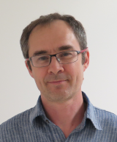
PUBLISHING INITIATIVE
APERTURE
Jean-Baptiste Poline
TOPIC Chair
Celebrating 25 Years!

Slide 14
An OHBM society initiative for a publishing platform
Not a classical journal:
        Publish new type of research object
            Tutorials, Notebooks, Software, Code, etc
        Non profit – as inexpensive as possible
        Society managed
        Open content – open source of the platform
        Quality
Celebrating 25 Years!

Slide 15
November 2017: Approval by council to launch the initiative
      Support for 3 years
February 2018: Canadian Open Neuroscience Platform (A. Evans) project launch and support for the initiative
May 2018: name APERTURE chosen
June 2018: Collaborative Knowledge (CoKo) Workshop
2018 Singapore Roundtable
September 2018: hiring developers for tuning platform
December 2018: Member Survey
2019 Rome Roundtable
Celebrating 25 Years!

Slide 16
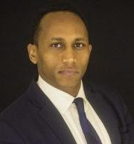
DIVERSITY & GENDER
INITIATIVES
Ishmael Ammareh
DGC Chair
Celebrating 25 Years!

Slide 17
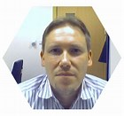

WHITE PAPER DEVELOPMENT
MEG/EEG White Paper
Multi-Modal White Paper
Cyril Pernet
COBIDAS Chair
Arno Villringer
Multi-Modal Chair
Celebrating 25 Years!

Slide 18
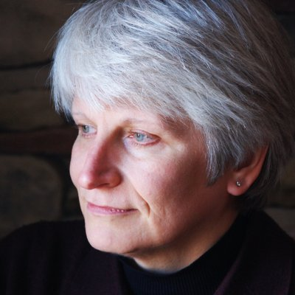
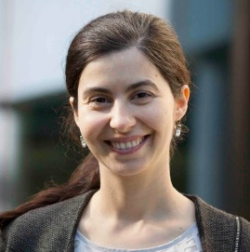
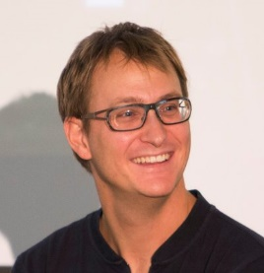
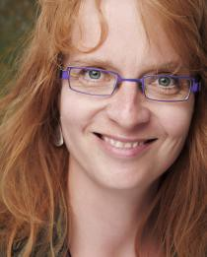
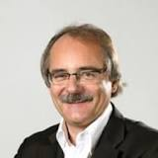
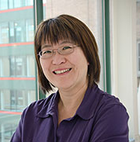


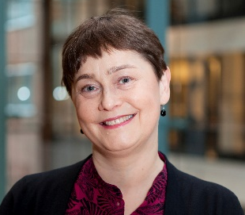
COBIDAS MEEG
Aina Puce, co-chair of the committee
@aina_puce
M. Garrido
@MartaIGarrido
Gramfort
@agramfort
N. Maurits
C. Michel
the team
E. Pang
R. Salmelin
J.M. Schoffelen
P. Valdes-Sosa
@sosa_valdes
Celebrating 25 Years!

Slide 19
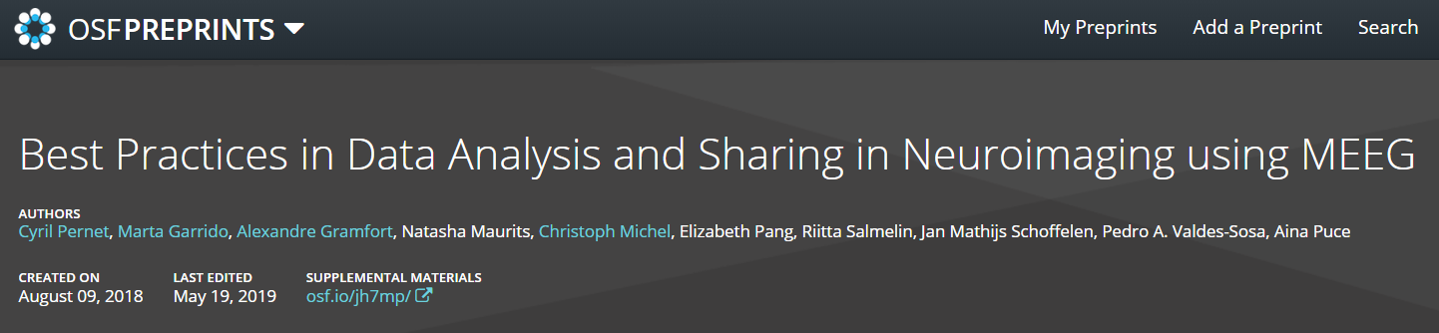
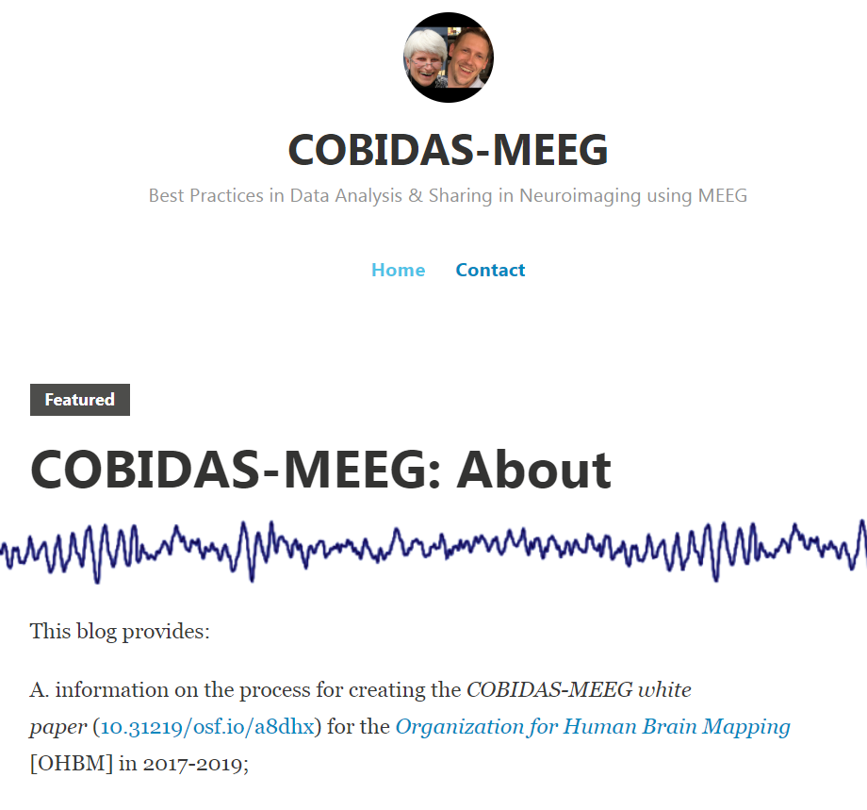
Version 2 is out!
https://osf.io/a8dhx/
https://cobidasmeeg.wordpress.com/

Slide 20
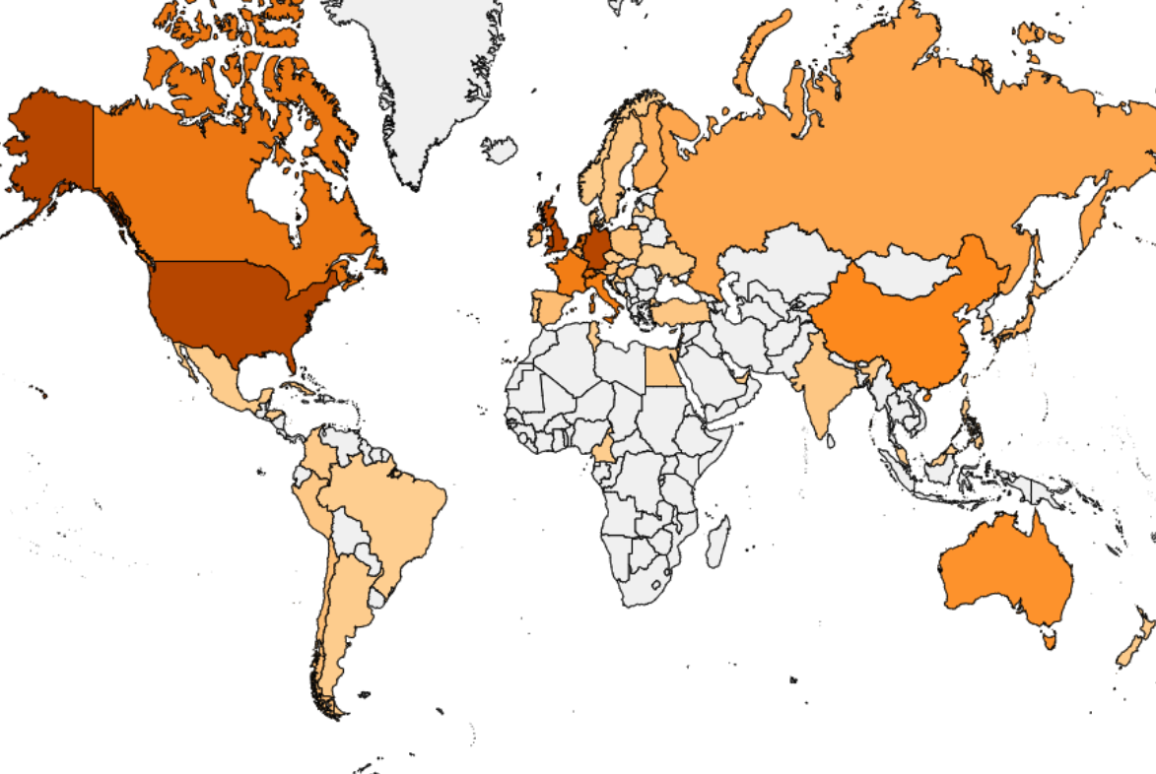
COBIDAS MEEG
Over 2500 views, 792 downloads of the preprint
> 100 people commented
Version 2 includes over 300 comments from the community
Looking for a journal to promote the initiative
Joint initiative with IFCN and ILAE (symposium this morning)
Celebrating 25 Years!

Slide 21
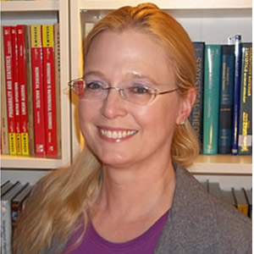
TREASURER’S REPORT
Jessica Turner
OHBM Treasurer
Celebrating 25 Years!

Slide 22
Celebrating 25 Years!

Slide 23
INVESTMENT POLICY STATEMENT
Secured Investment Advisor: Merrill Lynch
The OHBM sets this Statement of Investment Policy forth to:
Define and assign the responsibilities of all involved parties.
Establish a clear understanding of the investment goals and objectives for OHBM assets.
Provide guidance ensuring ethical investing and limitations to the investment manager regarding the investment of OHBM assets.
FINANCIAL RESERVE POLICY
The Organization shall have a goal of maintaining reserves of no less than fifty percent (50%) of the annual budgeted expenses (averaged over three years)
Celebrating 25 Years!

Slide 24
PRIMARY SOURCES OF REVENUES & EXPENSES
Numbers Based on 2018 Actuals
DESCRIPTION | REVENUE | EXPENSE
Member Dues | $ 295,400
Annual Meeting | $1,319,065 | $1,486,492
Professional Activities (includes costs associated with Council, Committees and SIGS) |  | $ 187,159
Administrative (includes costs associated with management, website, professional services, bank fees, general office supplies and operations, insurance and CME accreditation) |  | $ 353,246
OHBM’s Annual 990 Reporting Forms and Audit Reports are available upon request.
Celebrating 25 Years!

Slide 25
NEW FINANCIAL DEMANDS AS A SOCIETY
Member Recognition & Awards
Inclusiveness Initiatives
  Family Friendly Activities
  Child Care Grants
Standards Development
OnDemand Education
Society Publishing Platform
Collaborations
Celebrating 25 Years!

Slide 26
GOING BEYOND ANNUAL MEETING & MEMBER DUES
Fundraising
Webinars & Online Education
Publishing Platform
Celebrating 25 Years!

Slide 27
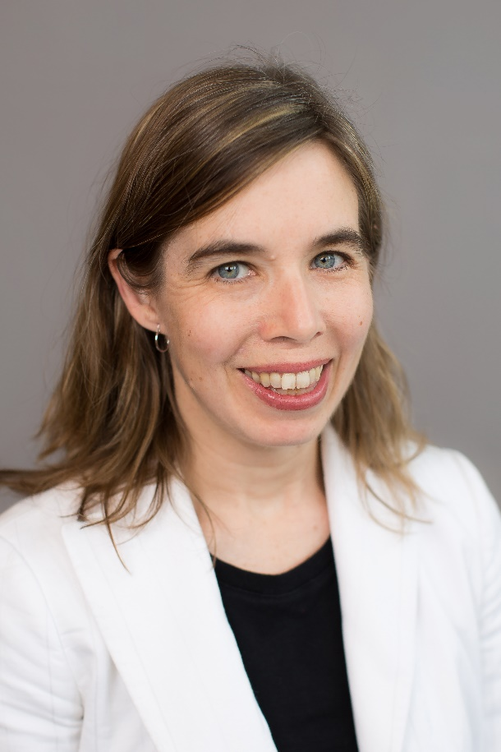
SECRETARY’S REPORT
Shella Keiholz
OHBM Secretary
Celebrating 25 Years!

Slide 28
MEMBER GROWTH TRENDS

Slide 29
2019 Membership as of May 31, 2019

Slide 30
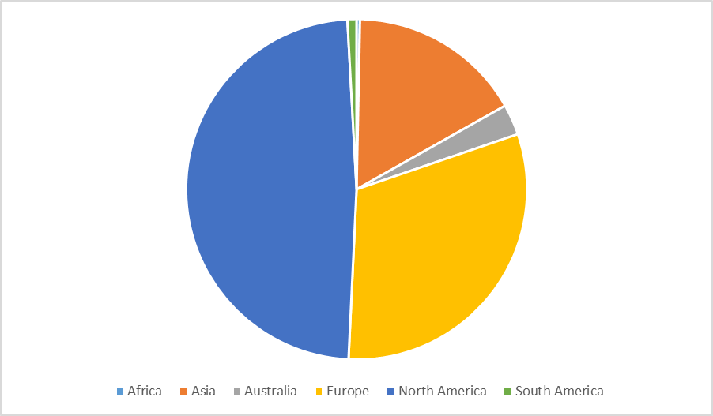
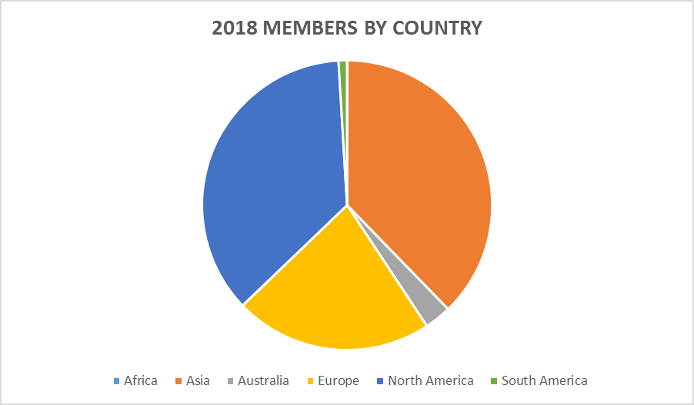
2017 Member Comparison
2019 MEMBERS BY CONTINENT

Slide 31
2019 MEMBERSHIP BY GENDER

Slide 32

2020 Annual Meeting
Montreal, Canada
June 25 – 29, 2020

Slide 33
2021 Annual Meeting
Seoul, Korea
June 27 – July 1, 2021

Slide 34
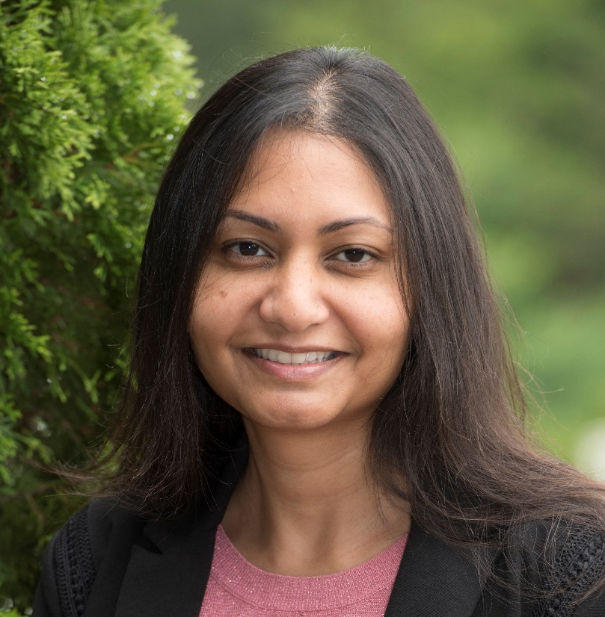
PROGRAM CHAIR REPORT
Lucina Uddin
OHBM Program Chair
Celebrating 25 Years!

Slide 35
ANNUAL MEETING HISTORICAL ATTENDANCE

Slide 36
2019 ANNUAL MEETING ATTENDEES BY CONTINENT

Slide 37
2019 ANNUAL MEETING ATTENDEES BY TYPE

Slide 38
2019 ANNUAL MEETING ATTENDANCE BY GENDER

Slide 39
ANNUAL MEETING TRAVEL AWARD SUMMARY

Slide 40
ANNUAL MEETING ABSTRACT SUMMARY

Slide 41
Category | Number of abstracts | Percentage of Abstracts
Brain Stimulation Methods | 120 | 3%
Disorders of the Nervous System | 738 | 21%
Emotion and Motivation | 51 | 1%
Genetics | 50 | 1%
Higher Cognitive Functions | 158 | 4%
Imaging Methods | 572 | 17%
Informatics | 96 | 3%
Language | 60 | 2%
Learning and Memory | 114 | 3%
Lifespan Development | 190 | 5%
Modeling and Analysis Methods | 755 | 22%
Motor Behavior | 56 | 1%
Neuroanatomy | 148 | 4%
Perception and Attention | 247 | 9%
Physiology, Metabolism and Neurotransmission | 43 | 1%
Social Neuroscience | 100 | 3%
Total | 3606 | 100.00%
2019 ANNUAL MEETING ABSTRACT SUBMISSIONS BY CATEGORY

Slide 42

EDUCATION CHAIR REPORT
Cameron Craddock
OHBM Education Chair
Celebrating 25 Years!

Slide 43
EDUCATIONAL COURSE HISTORICAL ATTENDANCE

Slide 44
STRATEGIC INITIATIVES FOR YEAR-ROUND EDUCATION
Core Strategy: To accelerate the development and adoption of new, effective education processes and strategies to engage and educate members on new approaches relevant to human brain organization.
Strategic Outcomes:
Create educational programming for under-represented audiences at the Annual Meeting.
Expand the use of educational content delivered at the Annual Meeting beyond the meeting (i.e., online education)
Create web-based and live streaming education and conferences both during the Annual Meeting and year round.
Utilize Chapters to deliver education and promote brain mapping research globally.
Celebrating 25 Years!

Slide 45
FEEDBACK FORUM
Vince Calhoun
Council Chair
Celebrating 25 Years!

Slide 46
ADJOURN
Celebrating 25 Years!

